Slide 1
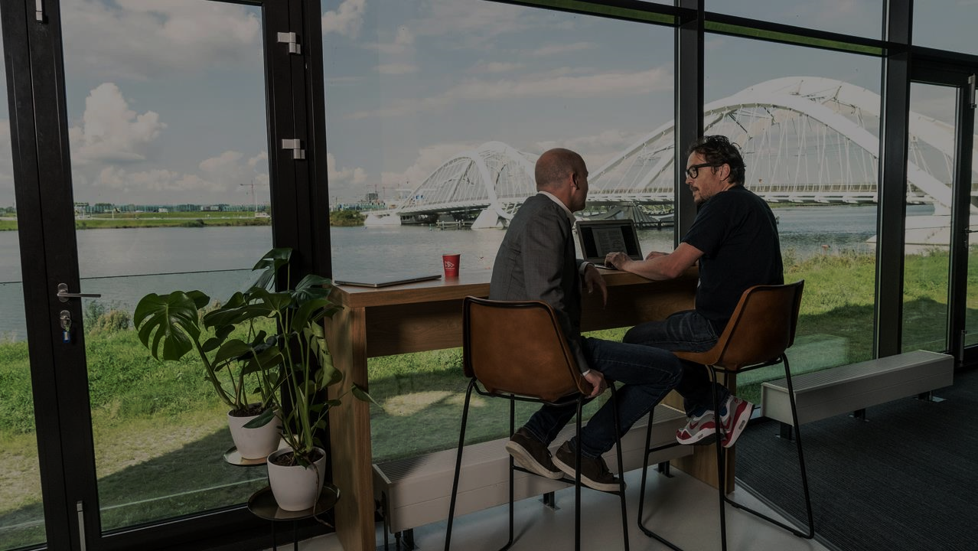

Docker
Angel Sevilla Camins

Slide 2


planning
Introducing Docker
Where Docker Fits In
What is Docker?
Docker components
Images, Layers, Containers
Docker Host, Client, Registry
Volumes, Networking
Managing Images and Containers
Docker Compose
Tools
Lab: Building and Managing Images

Slide 3
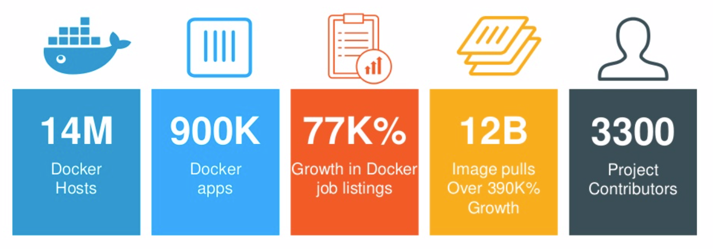
1. Introducing Docker
World’s leading container platform
Manage applications as containers running side-by-side
Solves “works on my machine” problems
Decouples hosts from services (in a lightweight fashion)
Image reference: Docker CEO Ben Golub - opening of the 2017 DockerCon

Slide 4
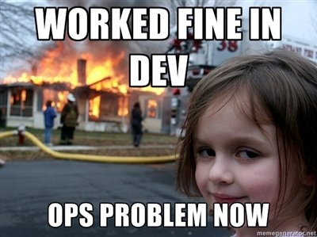

2. Where Docker fits in: Developers
Docker solves “works on my machine” problems
Development environment (dev) does not match production environment (ops).
Enforcing consistency of environments is difficult. Compounded when there are multiple or large teams of engineers.
Solution: wrap code in container. Run container in production.
For example a developer developing on macOS using the macOS version of e.g. PHP: even though PHP versions match with the Linux server that hosts the production code you will have to deal with potential differences in configuration and overall environment.

Slide 5
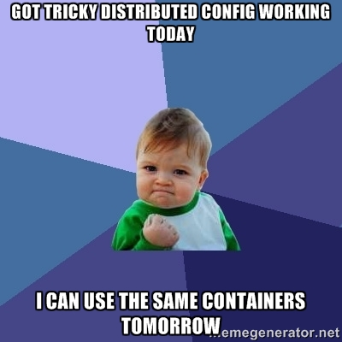
2. Where Docker fits in: OPERATIONS
Docker solves logistic problems around deploying, configuring and managing multiple (versions) of software stacks:
Modern services typically have many “moving parts”. E.g front end servers, API endpoints, Database or persistence back ends etc..
These moving parts might need to be run on shared hardware infrastructure.
These moving parts might have conflicting dependencies on OS features (e.g. service X needs lib Y.v1 and service Z needs lib Y.v2).
Hard to have consistent environments.
Solution: wrap services in container. Run multiple containers per host.

Slide 6
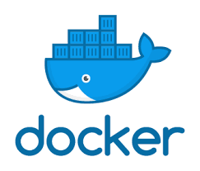
2. Where Docker fits in: THE ENTERPRISE
Docker closes gaps between dev and ops and facilitates automated testing:
Large development and operations teams.
Testing of software and infrastructure needed.
Multiple environments/configurations needed.
Solution: wrap services in container. Run multiple containers per host. Version images, run images for extended integration tests, deploy same images to test and production.

Slide 7
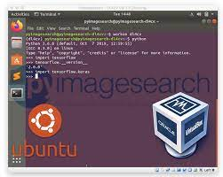
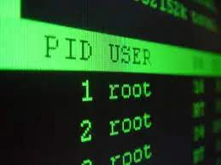
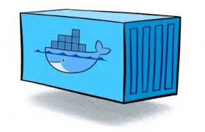
3. What is docker?
Docker offers isolation of environment and processes:
Process
• Isolate address space
• No isolation for files or networks
• Lightweight
Container
• Isolate address space
• Isolate files and networks
• Lightweight
Virtual Machine
• Isolate address space
• Isolate files and networks
• Heavyweight

Slide 8
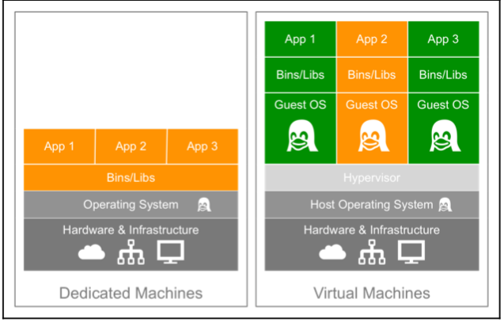
3. What is docker?

Slide 9
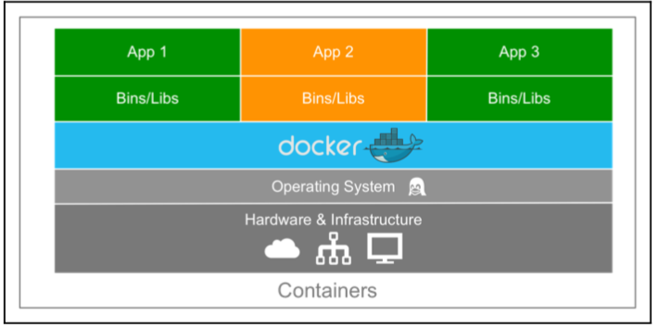
3. What is docker?

Slide 10
3. What is docker?
A few technologies make Docker possible:
Namespaces
What a process can see:
• Process ID (PID)
• Mount
• Network
• Interprocess communication (ipc)
• UTS (different host and domain)
• User ID
• Control Group
Control Groups
What a process can use:
• Memory
• CPU
• Devices
• Blkio
• Net_prio
• ….
Overlay File System
Image Storage:
• Read only layers
• Copy on write transient layer

Slide 11
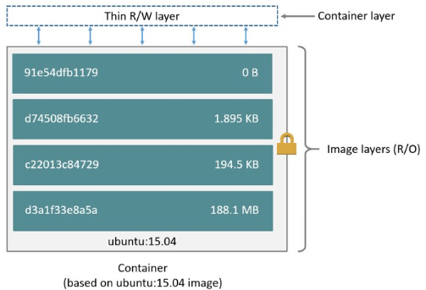
4. Docker components: Images, Layers, Containers
A Docker container image is structured in terms of “layers”: Process for building image
Start with base image
Load software desired
Commit base image+software to form new image
New image can then be base for more software
Image is what is transferred
Images become containers at runtime -> docker run
Notes:
- docker run creates writeable container layer, on top of read-only image layers
- Container layer is not persistent, removed after container is destroyed!
- Unless we use volume or bind mounting (see later)

Slide 12
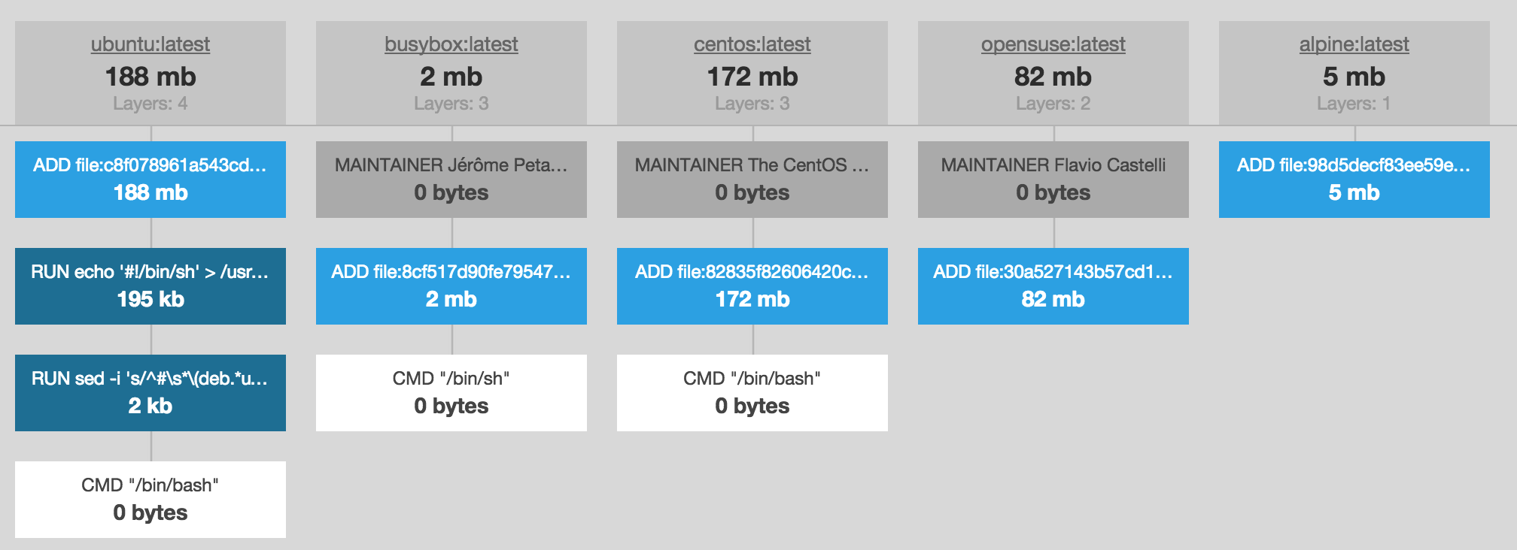
4. Docker components: BASE IMAGEs

Slide 13
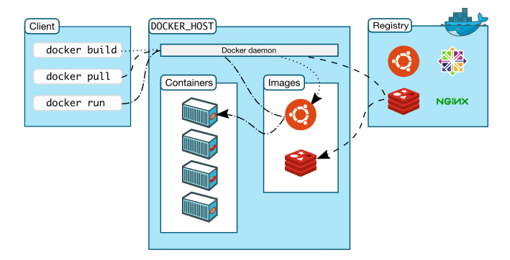
4. Docker components Docker Host, Client, Registry

Slide 14
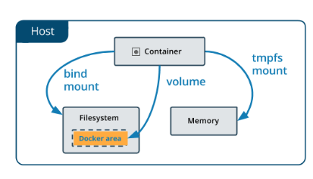
4. Docker components Volumes
Persist data outside the overlay file system:
Volume:
Are stored in a part of the host filesystem which is managed by Docker (/var/lib/docker/volumes/ on Linux).
Non-Docker processes should not modify this part of the filesystem.
Volumes are the best way to persist data in Docker.
Bind mount:
may be stored anywhere on the host system.
They may even be important system files or directories.
Non-Docker processes on the Docker host or a Docker container can modify them at any time.
tmpfs mounts:
are stored in the host system’s memory only
are never written to the host system’s filesystem.
Notes:
- Persistent volumes by using volume mount or bind mount
- docker run -v <volume_name>:<container_dir> <image> Volume mounting
- docker run -v <host_dir>:<container_dir> <image> Bind mounting
- docker run --mount type=bind,source=<host_dir>,target=<container_dir> <image> Newer syntax
- Storage drivers depend on underlying OS (example drivers: AUFS, ZFS, BTRFS, Device Mapper, Overlay, Overlay2)

Slide 15
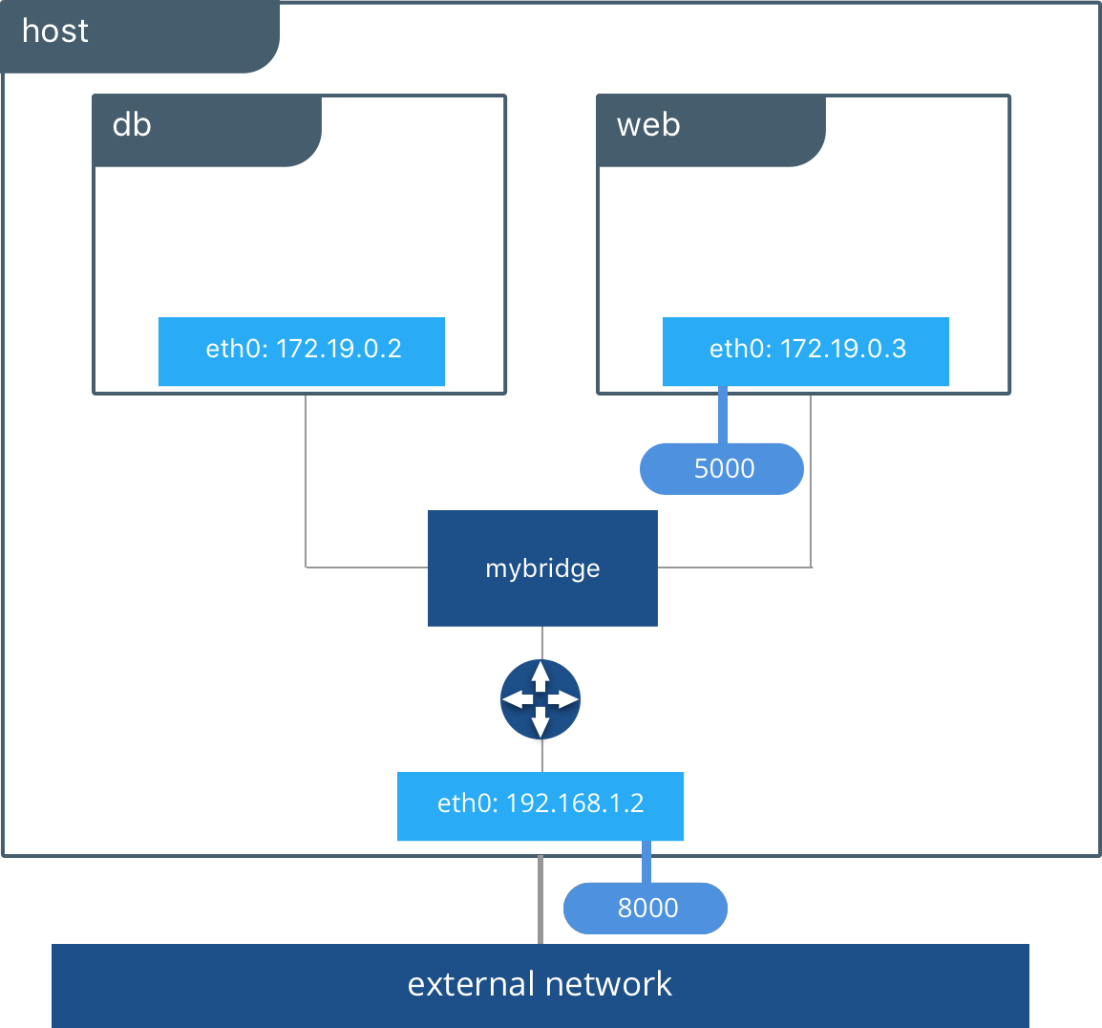
4. Docker components Networking
Docker’s networking subsystem is pluggable, using drivers. Several drivers exist by default, and provide core networking functionality:
Bridge: Default. Useful for standalone containers that need to communicate with each other.
Host: Removes network isolation between container and host. Accessible from outside.
Overlay: Connects multiple Docker daemons together.
None: No networking.
Notes:
- docker run <image> Bridged network (internal on docker host)
- docker run <image> --network=none No networking
- docker run <image> --network=host Accessible from outside
- docker network ls List networks

Slide 16
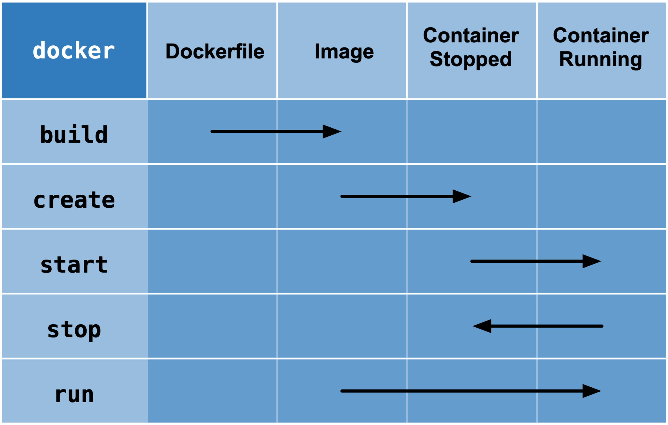
5. Managing Images and Containers
https://weibeld.net/misc/docker-cheatsheet.html

Slide 17
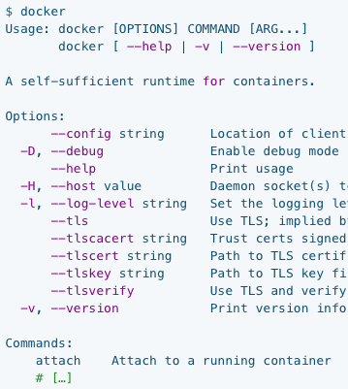
5. Managing Images and Containers
All via command line interface Docker (and Docker compose):
docker build -> based on ad Dockerfile create an image
docker run -> executes an image. An executing image is called a container
docker image ls -> generates a list of images known to Docker on your machine
docker container ls -> generates a list of containers that have been run
docker rm = docker container rm-> remove a container
docker rmi = docker image rm-> remove an image
docker {start, stop, kill…} -> start, stop kill a container
docker attach -> attach to a container
docker exec -> execute a command on a container
….
See: https://docs.docker.com/engine/reference/commandline/cli/

Slide 18
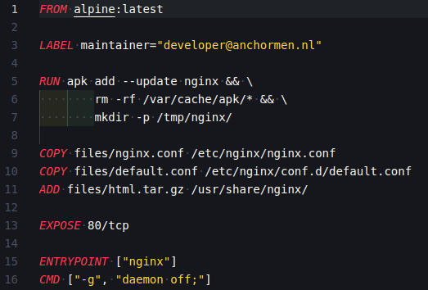
5. Managing Images and Containers Building images
ENTRYPOINT
Image specified in Dockerfile – list of instructions (commands):
VS
CMD
See: https://docs.docker.com/engine/reference/builder/
Notes:
FROM loading the base-image
RUN install some despendencies in one line
COPY config files
ADD for downloading files OR unzip compressed files, ...
EXPOSE, make a port reachable from
What is the difference between CMD and ENTRYPOINT? You cannot override the ENTRYPOINT instruction by adding command-line parameters to the docker run command.
By opting for this instruction, you imply that the container is specifically built for such use.
When ENTRYPOINT is defined, CMD value or docker run command merely add the new parameter to the existing command defined in ENTRYPOINT.

Slide 19
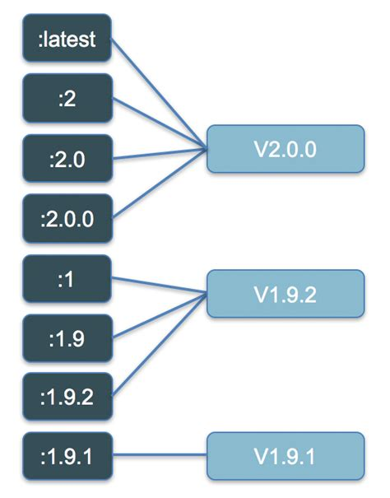
5. Managing Images and Containers Versioning
docker build -t IMAGE_NAME:VERSION

Slide 20
5. Managing Images and Containers best practices
Use small base images
Prefer base images which you can inspect (Dockerfile source available) and are from a reputable source (official libraries).
Avoid creating many layers - each docker instruction in a dockerfile creates a new layer. So run multiple grouped commands in one RUN statement (use && to string them together)
Clean up temporary files in your builds
Don’t hard code configuration in your images. Use arguments, environment variables or configuration from a volume or mount.
Use ENTRYPOINT and CMD together to offer an overridable default
Run one! application/service per image
Run applications in the foreground and capture output to stdout/stderr
Expose persisted volumes and expose ports

Slide 21
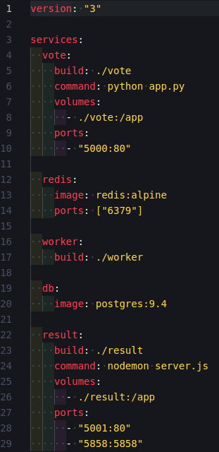
6. Docker Compose
Use Docker Compose if no container orchestration (Kubernetes, Swarm, Nomad) is available:
docker-compose command line:
• docker-compose up -> bring up services based on docker-compose.yml
• docker-compose {start, stop} -> start, stop services
• docker-compose down -> destroy all services based configuration
• ….
See: https://docs.docker.com/compose/reference/overview/
See: https://docs.docker.com/compose/compose-file/

Slide 22
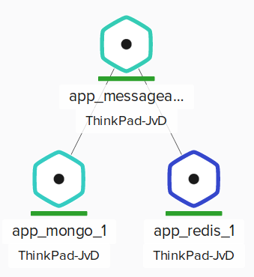
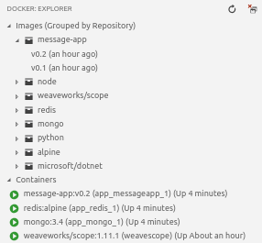
7. tools
Weave Scope - Visualize docker environment https://www.weave.works/docs/scope/latest/installing/
Visual Studio Code users Docker Explorer: https://github.com/formulahendry/vscode-docker-explorer

Slide 23
7. Tools: CHEAT sheet

Slide 24
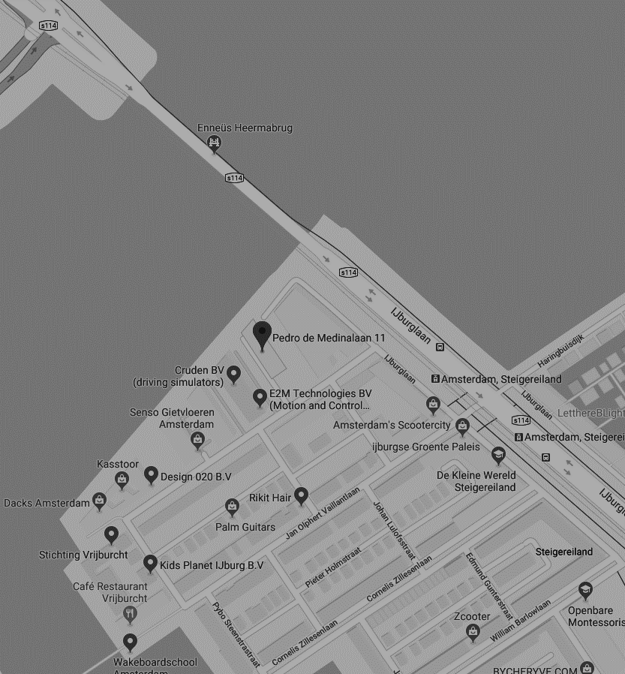
THANK YOU FOR YOUR ATTENTION
Pedro de Medinalaan 11, 1086 XK Amsterdam
020 - 773 1972
www.anchormen.nl

